Slide 1


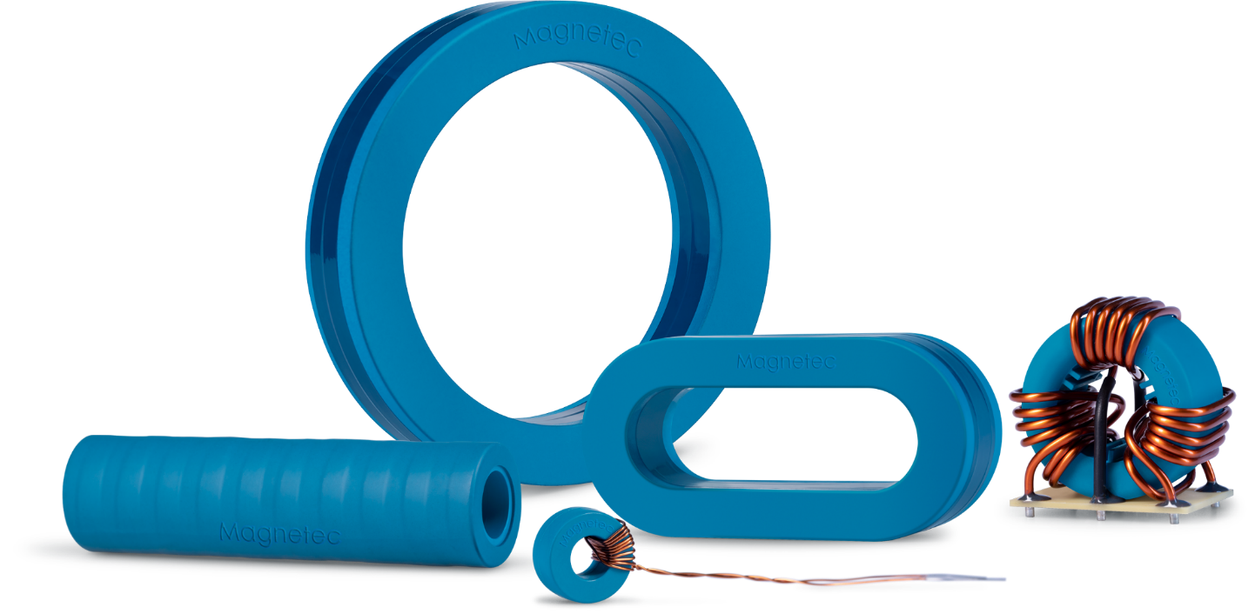

Efficiency is
our passion

Slide 2

PROFESSIONAL PROFILE
-Managing Director Magnetec Group since 2018
-Many years of experience in multinational companies
-Commercially and strategically astute business leader
-Internationally experienced at transforming and develop business
-instinctive eye for new applications and products, combined with an understanding for the markets and clients need with an in-depth knowledge of how to develop the product, process and service offering
-experienced in market initiatives to increase market share and build brand awareness and positively impact the top/bottom line
-Degree as Dipl.-Wirt-Ingenieur at University of Applied Sciences in Business Administration & Technical Engineering
- Degree as Electrician at Höhere Fachschule für Elektrotechnik
Marc Nicolaudius
-Managing Director-
Marc.Nicolaudius@magnetec.de
+49 173 6694481

Slide 3
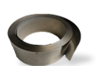
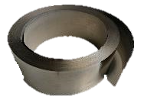
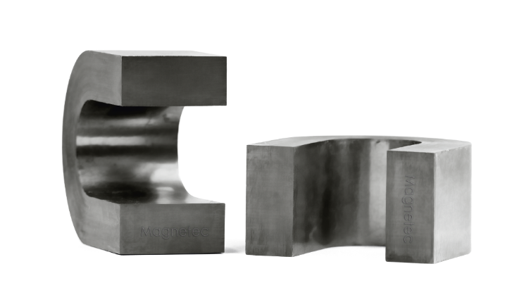
Nanoperm®
Our foundation for cores and chokes
Nanocrystalline structure
Iron alloy
Soft magnetic properties
Realization of different shaped hysteresis loops (F-, R- and Z-shape) possible
Various permeability values & dimensions
High saturation magnetization level
Low power loss
Low temperature dependency

Slide 4

Application Areas
Small components with a big effect

Slide 5




Business units
Automotive
EMC reduction in electric vehicles
Fault current detection in the charging infrastructure of electric vehicles
Energy
EMC reduction in:
Generators
Inverters
Transformers
Smart meter
HVAC systems
Industry
EMC reduction in frequency inverter
Motor bearing protection
Safety
Current transformers and sensor elements in electrical installations

Slide 6
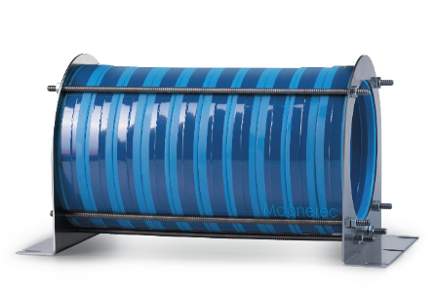
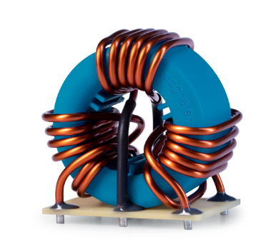
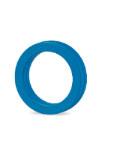
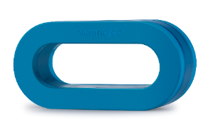
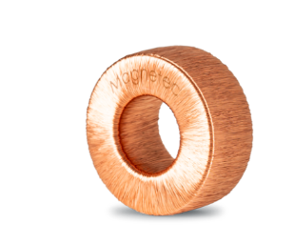
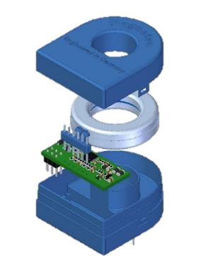
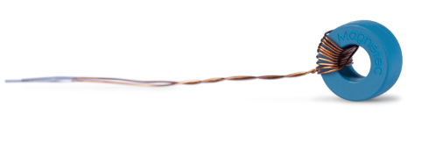
Product portfolio
EMC cores
CoolBlue®
CoolTube®
NaLA®
Inductive components
Residual current sensors
MAGBlue &
SafeBlue®
Current transformers
Drosseln
Stromwandler
Automotiv EMV Kerne

Slide 7
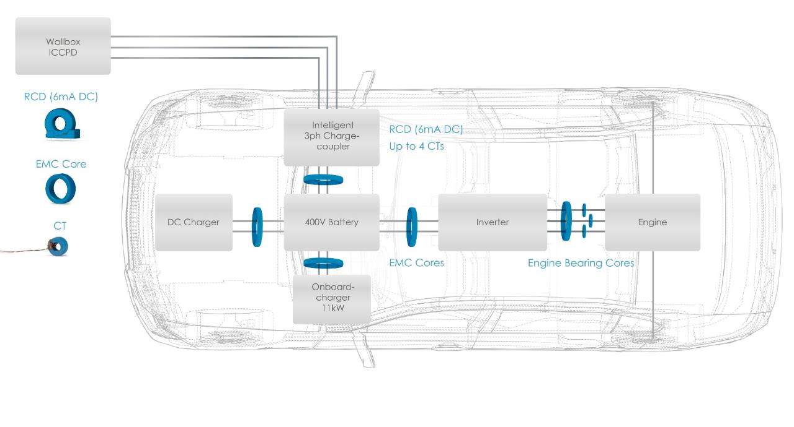
Business unit Automotive
EMC in vehicle electrical system and powertrain
Reduction of the motor bearing currents in the drive unit of the electric vehicles
Increase in operational reliability and service life
Reduction of electromagnetic interference signals

Slide 8
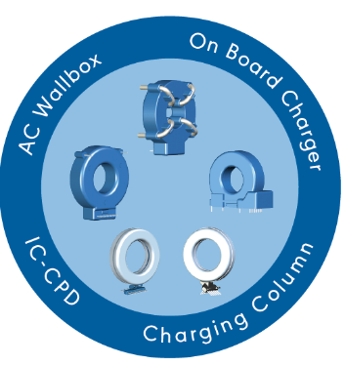
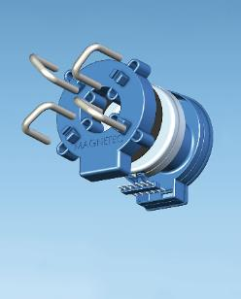
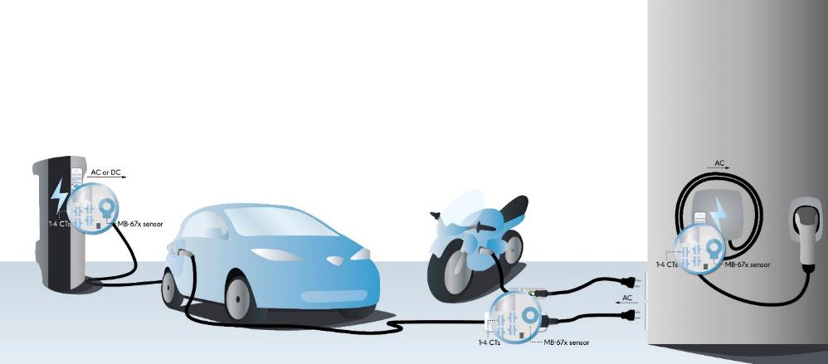
Business unit Automotive
MAGBlue Sensor for fault current detection
Precise fault current detection
6mA DC/direct currents
30mA AC/alternating currents
Reliable interruption of the circuit
Protection for the user
Protection of the type A circuit breaker of the home electronics
Integrated self-monitoring and test functions

Slide 9

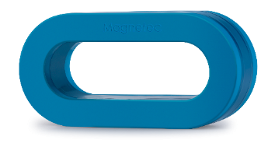

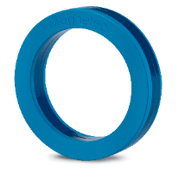


Business unit Industry
Motor bearing protection
Reduction of conducted emissions
Frequency range from 150kHz to 30 MHz
Reduction of interference due to high load on the lines
Link product video
Good absorption, high saturation flux density
Easy installation
Effective, cost-efficient & maintenance-free
Standard EMC cores from 16 mm to 300 mm outer diameter
Permeability range: 500 to 90,000

Slide 10

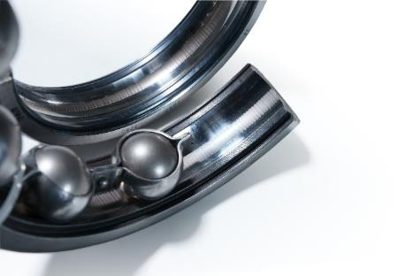
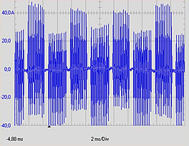
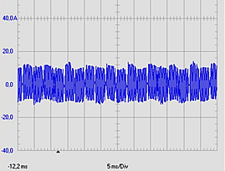
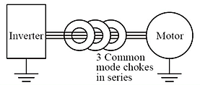
Business unit Energy
Motor bearing protection for wind turbines
On frequency converter controlled electric motors
Reduction of interference from radiated emissions
Cost reduction by saving expensive and high-maintenance components such as insulated bearings and grounding rings
Easy installation and retrofitting of existing systems
Link
without filter core
with Nanoperm® filter core

Slide 11

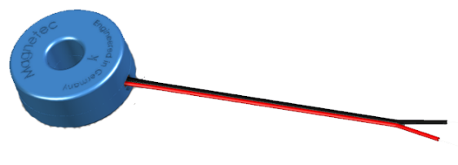
Business unit Safety
Current transformer, e.g. in the RCD
Use of residual current transformers with nanocrystalline toroidal cores for the detection of fault currents
Flexible core dimensions
Very wide permeability range, adapted to the required sensitivity
Defined stable temperature dependence in the range -25 ... + 100°C

Slide 12
Future Trends for Nanocrystalline Applications / Products
The market is in a constant development. The main challenges we see currently in the following areas:
Weight & Space!!!
Higher Frequency (100kHz)
Heat absorption
Shielding
Different shapes, e.g. oval, retancular….
This requires further research and development activities on materials and processes to develop new materials with different characteristics.

Slide 13
Establishing of new Nano-Products / new applications
Customers do not want to have simple products/components anymore
EMC / Application environment is too complex and knowledge and resources are limited
More „complex“ applications are needed to be successful
Many times a ready to use product (e.g. nano plus electronics) is required
Huge potentials are visible in the area of sensors and (active) Filters

Slide 14
Future Challenges Development
Knowledge Gap in the market / at customers
Developers do not know enough about Nanocrystalline materials/products
Too less information and tools for testing & simulation available
Early start of development with end customers needed
Too many wrong promises from “experts” which cannot be achieved

Slide 15
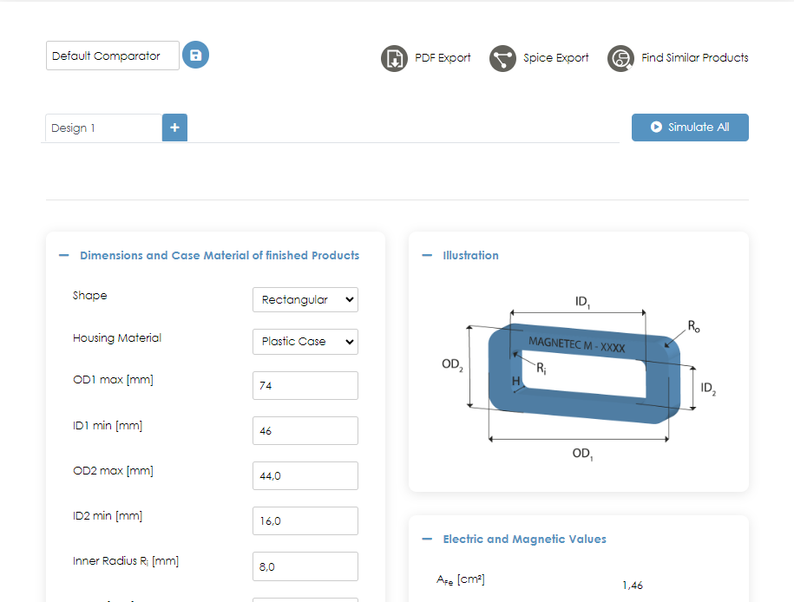
Simulation Tool
https://simtool.magnetec.de

Slide 16
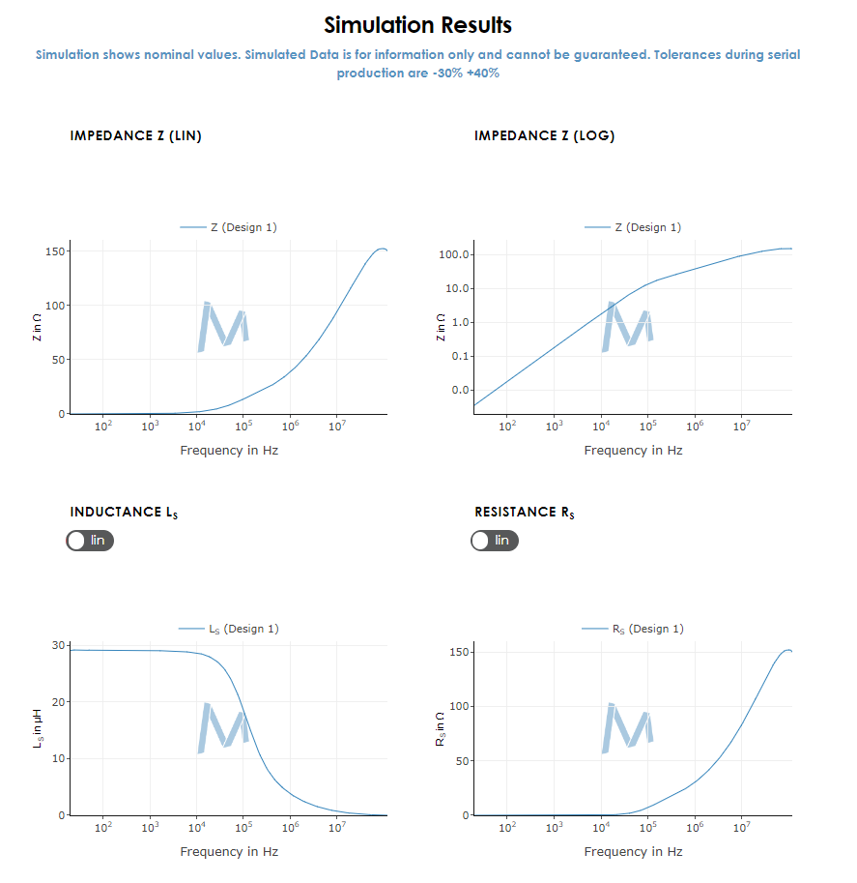
Simulation Tool
https://simtool.magnetec.de

Slide 17
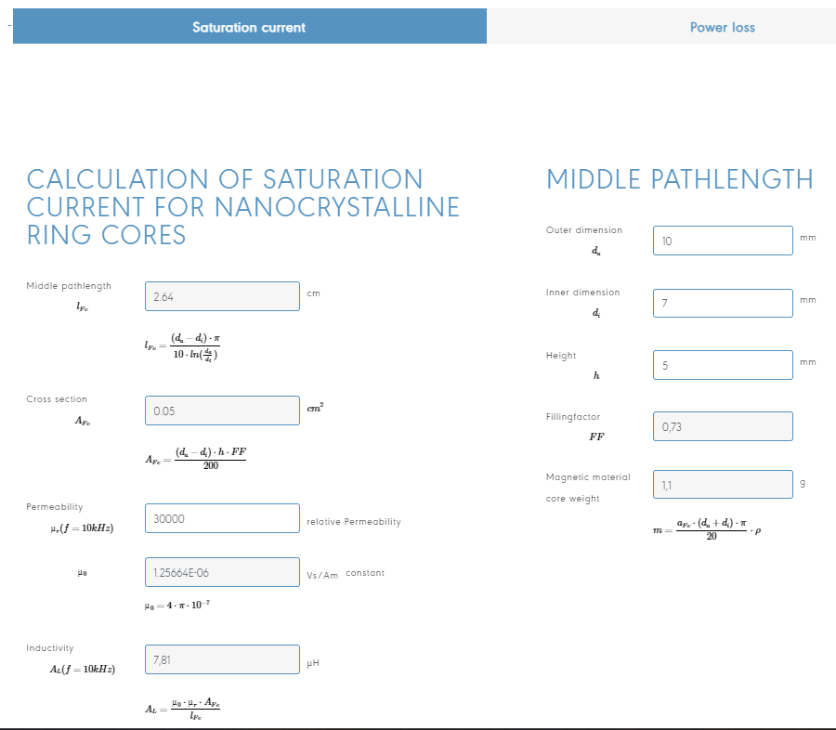
Calculation Tool
https://www.magnetec.de/calculation-tool

Slide 18
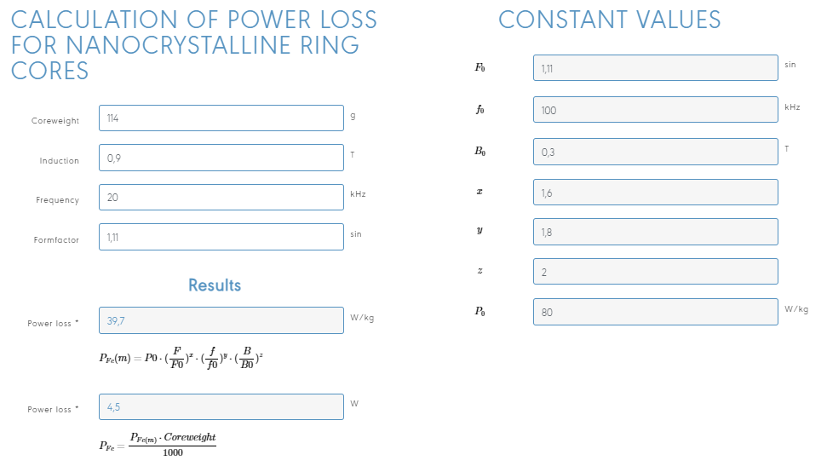
Calculation Tool
https://www.magnetec.de/calculation-tool

Slide 19
Future Challenges External
Strong dependency on China
More and more restrictions effecting Customers, Taxes, Costs and SC -> Step out of China is a requirement
Limited competition due to political interventions (regulations, taxes)
Constant SC-issues as a result effecting costs and deliveries

